Slide 1
Security and Privacy
Fall 2019
Instructor: Saeed Samet
School of Computer Science
University of Windsor

Slide 2
Chapter 5
Database Security and Inference Controls

Slide 3
Chapter Outline
Introduction
Security Requirements
Reliability and Integrity
Sensitive Data
Inference
Controls for Statistical Inference Attacks

Slide 4
Introduction
Database is a collection of data and a set of rules that organize the data by specifying certain relationships among the data
The database file consists of
Records: Each contains one related group of data
Fields or elements: the elementary data items inside each record
Attribute: The name of each column
Relation: a set of columns
Query: A command, such as retrieve, modify, add, or delete fields and records of the database
SQL: A structured query language

Slide 5
Introduction (cont.)
Advantages over a simple file system:
Shared access: users can use one common, centralized set of data
Minimal redundancy: individual users do not have to collect and maintain their own sets of data
Data consistency: a change to a data value affects all users of the data value
Data integrity: data values are protected against accidental or malicious changes
Controlled access: only authorized users are allowed to view or to modify data values

Slide 6
Security Requirements
Physical database integrity
The data of a database are immune to physical problems, such as power failures
It can be reconstructed if it is destroyed through a catastrophe
Logical database integrity
The structure of the database is preserved
A modification to the value of one field does not affect other fields, for example.
Element integrity
The data contained in each element are accurate

Slide 7
Security Requirements (cont.)
Auditability
It is possible to track who or what has accessed (or modified) the elements in the database
Access control
A user is allowed to access only authorized data
User authentication
Every user is positively identified, for the audit trail and for permission to access certain data.
Availability
Users can access the database in general and all the data for which they are authorized

Slide 8
Security Requirements (cont.)
Integrity
Database Integrity
The responsibility of the DBMS, OS, and the (human) computing system manager
Regular backup
Reconstruct the database at the point of a failure
Using most recent backup and transaction log
Element Integrity
Correctness or Accuracy of the elements
The responsibility of the DBMS and authorized users
Field checks: test for appropriate values in a position
Access control
Change log: lists every change made to the database

Slide 9
Security Requirements (cont.)
Auditability
To maintain database’s integrity
To discover after the fact who had affected which values and when
To access protected data incrementally
Access control
The database administrator specifies who should be allowed access to which data, at the view, relation, field, record, or even element level
The problem of obtaining data values from others is called inference

Slide 10
Security Requirements (cont.)
User authentication
DBMS runs as an application program on top of the OS
This system design means that there is no trusted path from the DBMS to the OS, so the DBMS must be suspicious of any data it receives, including user authentication
Thus, the DBMS is forced to do its own authentication
Availability
Two users may request the same record, and one user is bound to be denied access for a while by the DBMS
DBMS may withhold unprotected data to avoid revealing protected data

Slide 11
Reliability and Integrity
Database Concerns
Database integrity: Database as a whole is protected against damage
Failure of a disk drive
Corruption of the master database index
Addressed by OS integrity controls and recovery procedures
Element integrity: The value of a specific data element is written or changed only by authorized users
Proper access controls protect a database from corruption by unauthorized users
Element accuracy: Only correct values are written into the elements of a database
Checks on the values of elements can help prevent insertion of improper values
Constraint conditions can detect incorrect values

Slide 12
Reliability and Integrity (cont.)
Two-Phase Update
In case of failure of the computing system in the middle of modifying data
Intent phase
Prepare for the update, but it makes no changes to the database
DBMS gathers the resources it needs to perform the update
Gather data
Create dummy records
Open files
Lock out other users
Calculate final answers
Commit phase
Perform permanent changes into the database

Slide 13
Reliability and Integrity (cont.)
Redundancy/Internal Consistency
Maintain additional information to detect internal inconsistencies in data
Error Detection and Correction Codes
Parity bits, Hamming codes, and cyclic redundancy checks.
Can be applied to single fields, records, or the entire database
Shadow Fields
Entire attributes or records can be duplicated in a database
Recovery
DBMS maintains a log of user accesses and data changes
In the event of a failure, the database is reloaded from a backup copy and all later changes are then applied from the audit log

Slide 14
Reliability and Integrity (cont.)
Concurrency/Consistency
Accesses by two users sharing the same database must be constrained so that neither interferes with the other
Read-Modify
DBMS treats the entire query–update cycle as a single atomic operation
Read-Write
DBMS locks any read requests until a write has been completed

Slide 15
Reliability and Integrity (cont.)
Monitors
Units of a DBMS responsible for the structural integrity of the database
Check values being entered to ensure their consistency with the rest of the database or with characteristics of the particular field
Range Comparisons
To ensure that the value is within an acceptable range
State Constraints
Describe the condition of the entire database
At no time should the database values violate these constraints
Example: No duplicate on the Employee codes

Slide 16
Reliability and Integrity (cont.)
Monitors (cont.)
Transition Constraints
Describe conditions necessary before changes can be applied to a database
Example: before a new employee can be added to the database, there must be a position number in the database with status “vacant”

Slide 17
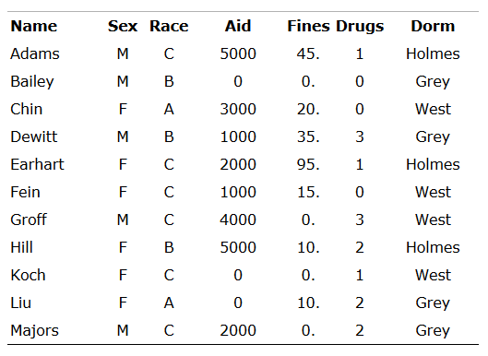
Sensitive Data
Data that should not be made public
There may be varying degrees of sensitivity
Security concerns not only the data elements but also their context and meaning

Slide 18
Sensitive Data (cont.)
Several factors can make data sensitive
Inherently sensitive: The value itself may be so revealing that it is sensitive
Examples are the locations of defensive missiles or the median income of barbers in a town with only one barber.
From a sensitive source: The source of the data may indicate a need for confidentiality
An example is information from an informer whose identity would be compromised if the information were disclosed.
Declared sensitive: The database administrator or owner may have declared the data to be sensitive
Example: classified military data
Part of a sensitive attribute or a sensitive record: an entire attribute or record may be classified as sensitive
Example: salary attribute of a personnel database
Sensitive in relation to previously disclosed information: Some data become sensitive in the presence of other data
Example: the longitude coordinate of a secret gold mine reveals little, but the longitude and latitude coordinates pinpoints the mine.

Slide 19
Sensitive Data (cont.)
Access Decisions Factors
Availability of the data
When performing an update, a user may have to block access to several fields or several records to ensure the consistency of data for others
Acceptability of the access
One or more values of the record may be sensitive and not accessible by the general user
Authenticity of the user
Certain characteristics of the user external to the database may also be considered when permitting access
Administrator may permit someone to access the database only at certain times
Previous user requests may also be taken into account
Sensitive data can sometimes be revealed by combined results from several less sensitive queries

Slide 20
Sensitive Data (cont.)
Types of Disclosures
Exact Data
Bounds
Indicating that a sensitive value, y, is between two values, L and H
Negative Result
A query to determine a negative result, learning that z is not the value of y
Existence
The existence of data itself can be a sensitive piece of data, regardless of the actual value
Probable Value
Determine the probability that a certain element has a certain value

Slide 21
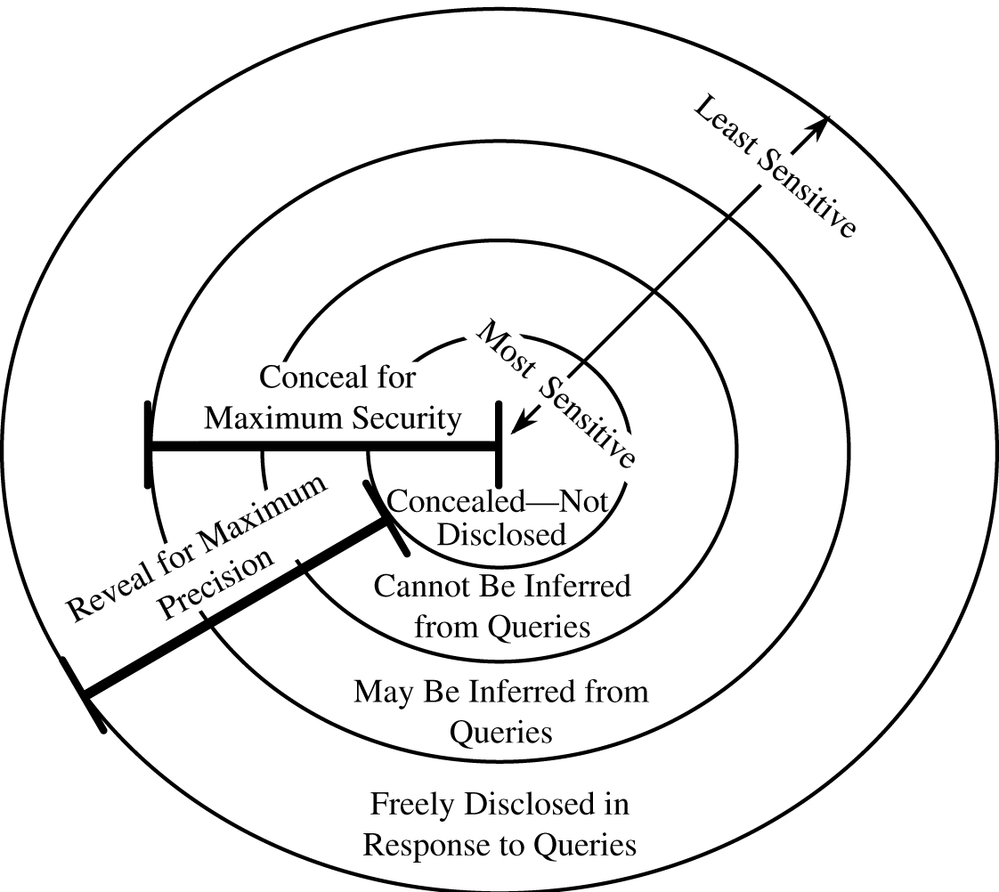
Sensitive Data (cont.)
Security versus Precision
Precision: disclose as much data as possible so that users of the database have access to the data they need

Slide 22
Inference
A way to infer or derive sensitive data from non-sensitive data
Direct Attack
A user tries to determine values of sensitive fields by seeking them directly with queries that yield few records
The most successful technique is to form a query so specific that it matches exactly one data item
Example
List NAME where SEX=M ∧ DRUGS=1
or
List NAME where (SEX=M ∧ DRUGS=1) ∨
(SEX≠M ∧ SEX≠F) ∨
(DORM=AYRES)

Slide 23
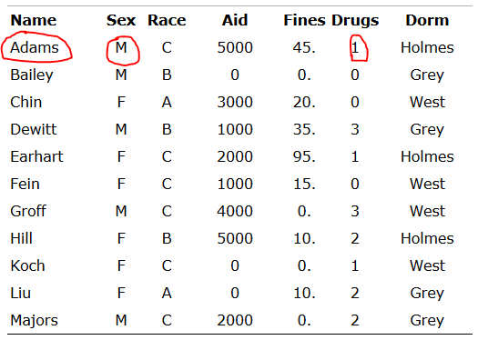
Inference (cont.)

Slide 24
Inference (cont.)
One solution
Do not reveal results when a small number of people make up a large proportion of a category.
The rule of “n items over k percent” means that data should be withheld if n items represent over k percent of the result reported
In the example, the one person selected represents 100 percent of the data reported, so there would be no ambiguity about which person matches the query

Slide 25
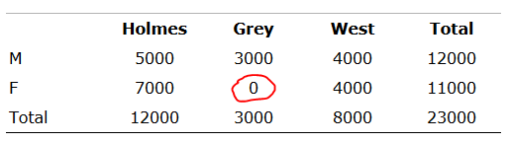
Inference (cont.)
Indirect Attack
Seeks to infer a final result based on one or more intermediate statistical results
A statistical attack seeks to use some apparently anonymous statistical measure to infer individual data
Sum
Infer a value from a reported sum
Student aid total by sex and dorm

Slide 26
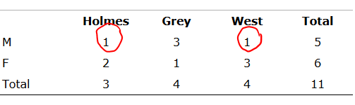
Inference (cont.)
Indirect Attack (cont.)
Count
Can be combined with the sum to produce some even more revealing results
count of records for students by dorm and sex

Slide 27
Inference (cont.)
Indirect Attack (cont.)
Mean
Allows exact disclosure if the attacker can manipulate the subject population
Example
Given the number of employees, the mean salary for a company and the mean salary of all employees except the president, it is easy to compute the president’s salary
Median
By a slightly more complicated process, we can determine an individual value from medians
The attack requires finding selections having one point of intersection that happens to be exactly in the middle

Slide 28
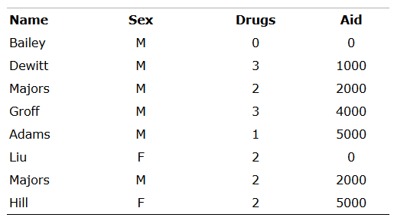
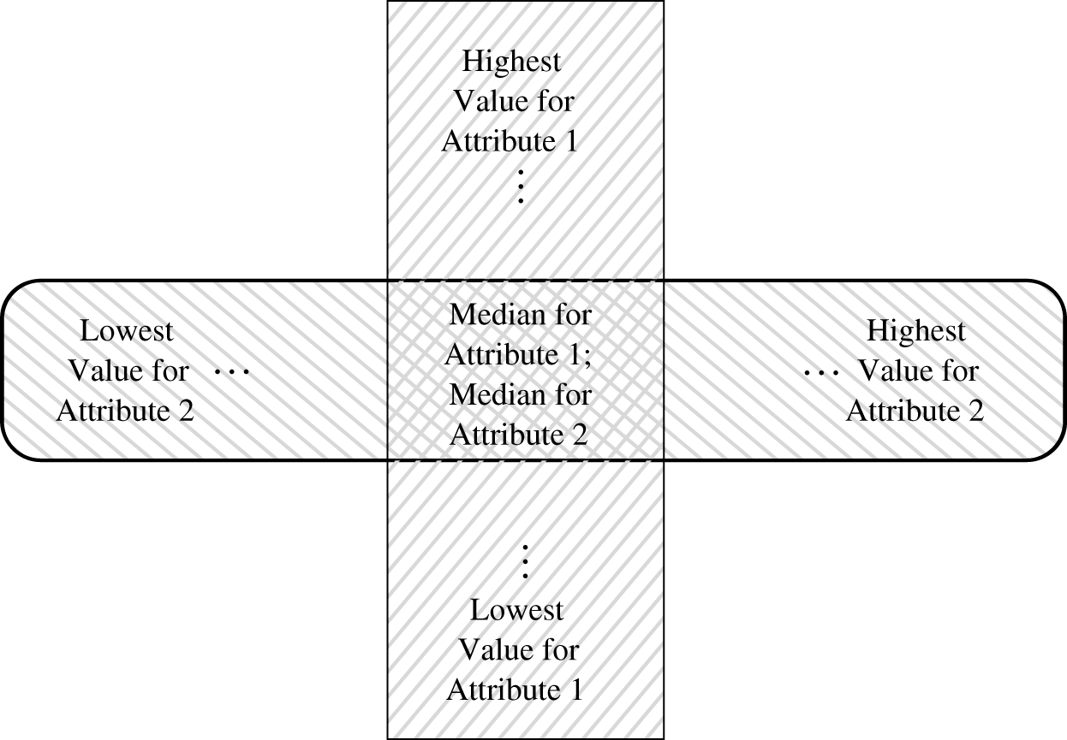
Inference (cont.)
Indirect Attack (cont.)
Median (cont.)
Example
Intersecting Medians
q = median(AID where SEX = M)
p = median(AID where DRUGS = 2)

Slide 29
Inference (cont.)
Indirect Attack (cont.)
Tracker Attacks
The tracker adds additional records to be retrieved for two different queries
The two sets of records cancel each other out, leaving only the statistic or data desired
count ((SEX=F) ∧ (RACE=C) ∧ (DORM=Holmes))
count (SEX=F) - count ((SEX=F) ∧ ((RACE≠C) ∨ (DORM ≠ Holmes)))

Slide 30
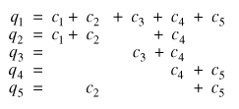

Inference (cont.)
Indirect Attack (cont.)
Linear System Vulnerability
The general case of Tracker

Slide 31
Controls for Statistical Inference Attacks
Two ways to protect against inference attacks
Controls are applied to the queries
Controls are applied to individual items within the database
Suppression
Sensitive data values are not provided
The query is rejected without response
Concealing
The answer provided is close to but not exactly the actual value
Trade-off is between security and precision

Slide 32
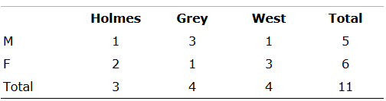
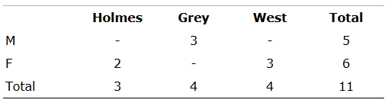
Controls for Statistical Inference Attacks (cont.)
Limited Response Suppression
When one cell is suppressed in a table with totals for rows and columns, it is necessary to suppress at least one additional cell on the row and one on the column to provide some confusion

Slide 33
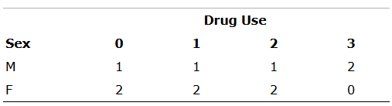
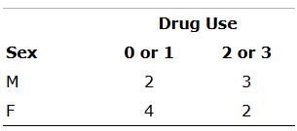
Controls for Statistical Inference Attacks (cont.)
Combined Results
To suppress sensitive information, combine the attribute values for some ranges or close values, producing the less sensitive results
Rounding values is another option
Rounding up or down to the nearest multiple of some base

Slide 34
Controls for Statistical Inference Attacks (cont.)
Random Sample
Result is not derived from the whole database
Instead the result is computed on a random sample of the database
The sample should be chosen large enough to be valid
Random Data Perturbation
Perturb the values of the database by a small error
Query Analysis
Query and its implications are analyzed to determine whether a result should be provided
Example: maintaining a query history for each user

Slide 35
Controls for Statistical Inference Attacks (cont.)
Conclusion on the Inference Problem
No perfect solutions to the inference problem
Possible approaches
Suppress obviously sensitive information
Track what the user knows
Disguise the data
Aggregation
Building sensitive results from less sensitive inputs

